Slide 1

Strategic Merger Analysis in OTT Domain
CodeBasics Resume Challenge #14
Presented By: Dinesh Kumar S
Domain: Telecom & Streaming Services
Function: Strategy & Operations

Slide 2
Business Summary
Project Overview
Dataset
Dashboard Views
Primary Analysis
Secondary Analysis
Further Analysis & Recommendations
Conclusion
Agenda

Slide 3
Lio is a leading telecommunications provider in India which owns LioCinema, an OTT platform with a vast subscriber base.
Jotstar is one of the country's leading streaming platforms, known for its diverse content library.
Business Summary
Business Vision:
To revolutionize digital streaming in India by delivering a seamless, content-rich, and personalized viewing experience that caters to diverse audiences across the country.

Slide 4
Analysis Period:
January 1 to November 30, 2024
Key Areas of Analysis Expected by Management:
1.Content Library Analysis: A detailed comparison of content types across both platforms.
2. Subscriber Insights: Analyze trends in subscriber acquisition and demographic variations.
3. Inactivity Analysis: Patterns of inactivity across age groups, city tiers, and subscription plans.
4. Upgrade Patterns: Insights into subscription upgrades and their influencing factors.
5. Downgrade Patterns: Analysis of subscription downgrades and associated trends.
6. Content Consumption Behavior: Patterns in total watch time, device preferences, and variations by user demographics.
Project Overview
Lio wants to analyze the performance and user behavior of both platforms—LioCinema and Jotstar
Project’s Final Objective: The insights from this study will enable management to make data-driven decisions, aiming to establish Lio-Jotstar as India’s leading OTT platform

Slide 5

Jotstar-db.sql
Liocinema-db.sql
Table Name | Purpose
Contents | Stores details about movies & series and their Genre, Language and run time
Subscribers | Contains user details & subscription history
Content Consumption | Contains user’s watch time trends, device preferences.
Dataset
Notes:
Dataset was provided by codebasics team consists of two SQL databases: Jotstar.sql and LioCinema.sql. These databases contain detailed user and subscription data for both platforms

Slide 6

Dashboard Views
Notes:
Dataset was provided by codebasics team consists of two SQL databases: Jotstar.sql and LioCinema.sql. These databases contain detailed user and subscription data for both platforms

Slide 7
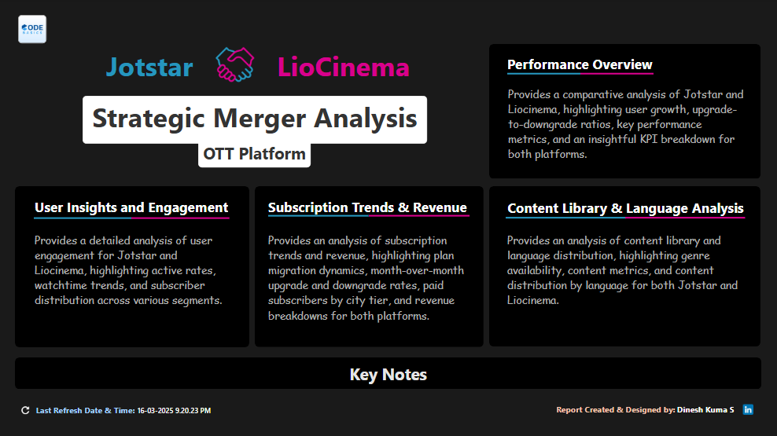

Slide 8
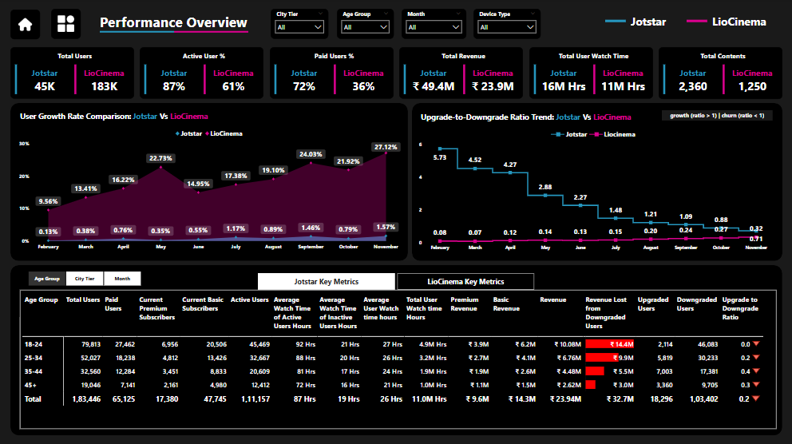

Slide 9
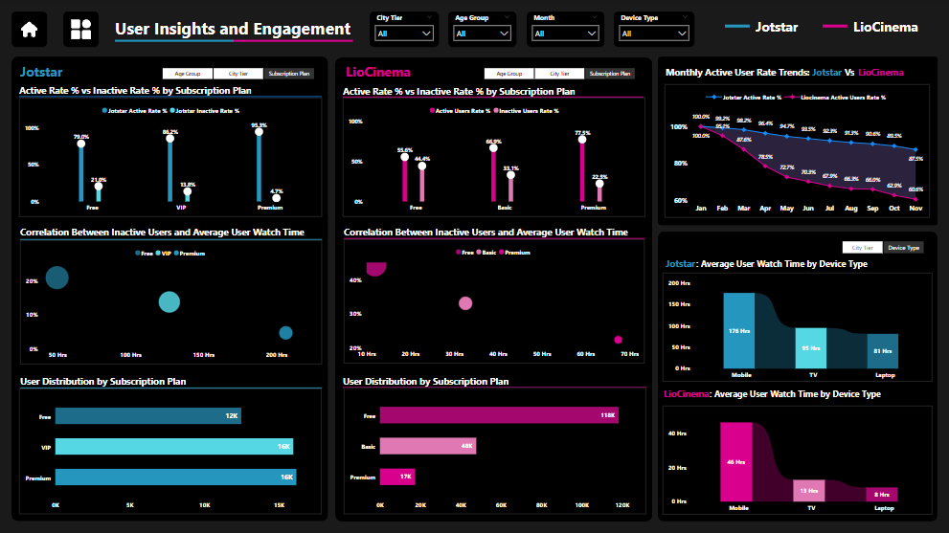

Slide 10
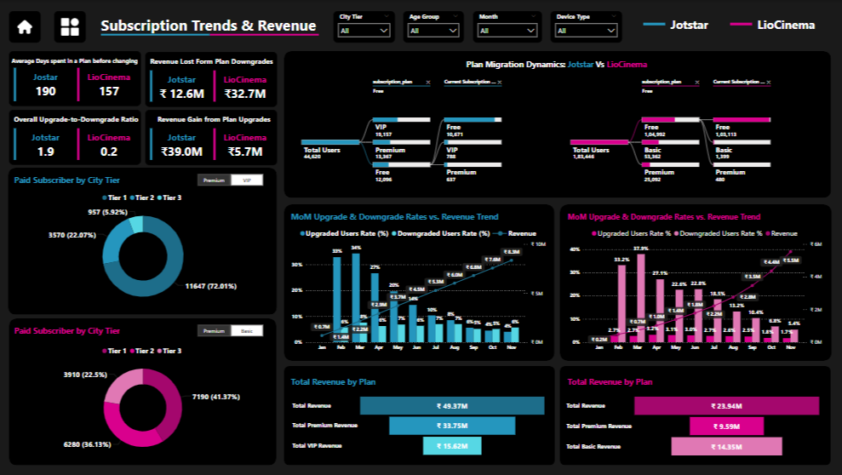

Slide 11
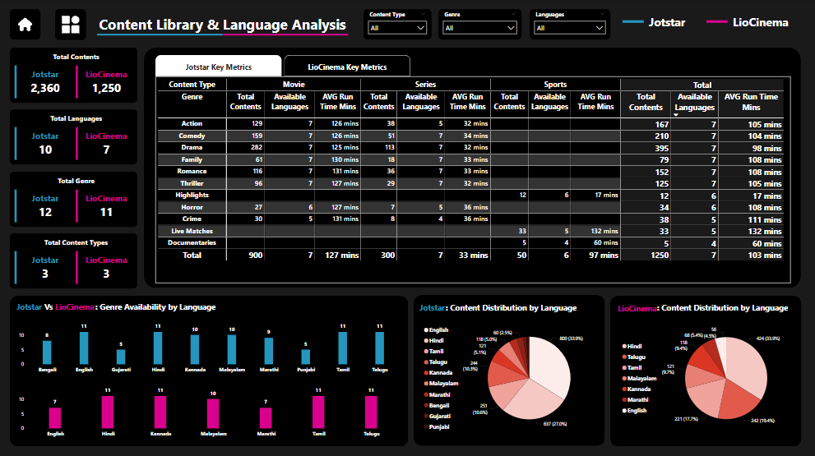

Slide 12
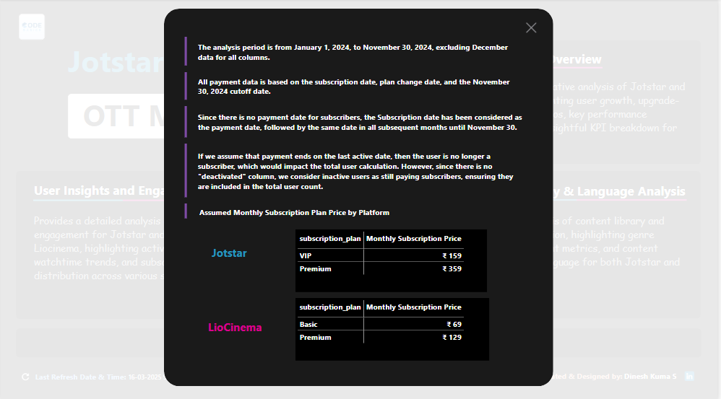
Key Notes View

Slide 13

Primary Analysis
Notes:
Dataset was provided by codebasics team consists of two SQL databases: Jotstar.sql and LioCinema.sql. These databases contain detailed user and subscription data for both platforms

Slide 14
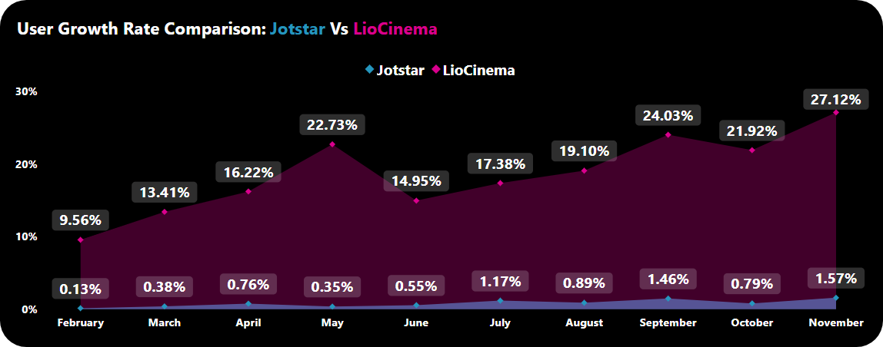
1. What is the total number of users for LioCinema and Jotstar, and how do they compare in terms of growth trends (January–November 2024)?
Key Insights: LioCinema: 183,446 users Jotstar: 44,620 users
LioCinema has more than 4X the user base of Jotstar.
LioCinema is experiencing rapid user adoption, whereas Jotstar's growth remains minimal.
In June, LioCinema experienced a sudden dip in user growth, dropping from 22.73% in May to 14.95% In June
Notes:
In June, LioCinema experienced a sudden dip in user growth, dropping from 22.73% in May to 14.95%, before recovering in the following months. This decline could indicate factors such as reduced content releases, seasonal variations, or increased competition. Meanwhile, Jotstar maintained a consistently low growth rate, showing minimal impact during this period.

Slide 15
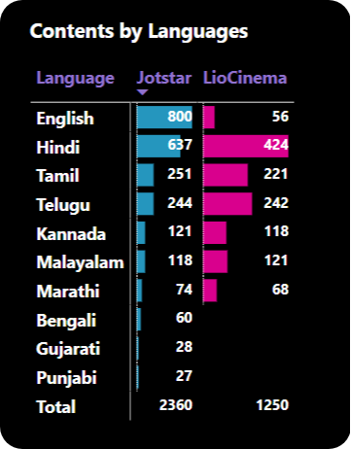
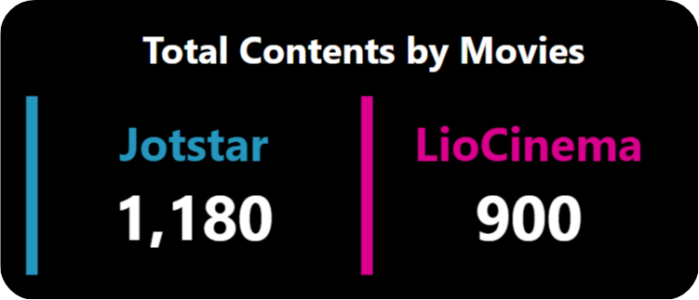
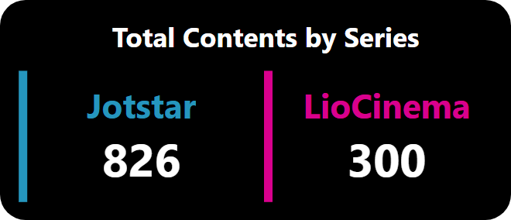
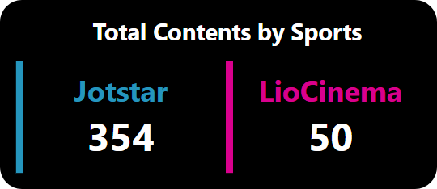
2. What is the total number of contents available on LioCinema vs. Jotstar? How do they differ in terms of language and content type?
Key Insights: LioCinema: 1250 Contents Jotstar: 2,360 Contents
Jotstar has nearly 2X the content of LioCinema
Jotstar excels in delivering sports and series content, making it a go-to platform for binge-watchers.
Jotstar offers more English content Compared to LioCinema
Jostar offers content in Bengali, Gujarati and Punjabi which are missing from LioCinema’s catalog.
Notes:
In June, LioCinema experienced a sudden dip in user growth, dropping from 22.73% in May to 14.95%, before recovering in the following months. This decline could indicate factors such as reduced content releases, seasonal variations, or increased competition. Meanwhile, Jotstar maintained a consistently low growth rate, showing minimal impact during this period.

Slide 16
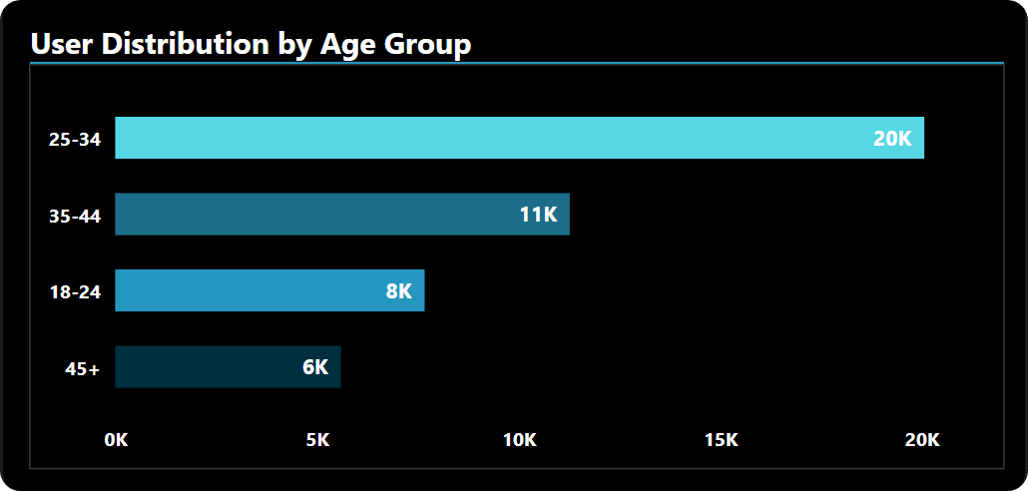
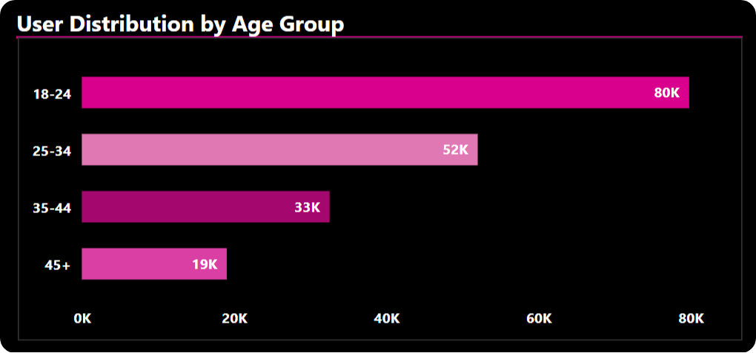
3. What is the distribution of users by age group, city tier, and subscription plan for each platform?
Jotstar
LioCinema
Key Insights By Age group:
Jotstar Dominates the 25-34 Age Segment – A significant portion of Jotstar's user base falls within this age group.
LioCinema Attracts a Younger Audience – The 18-24 age group prefers LioCinema, whereas Jotstar struggles to capture this demographic.
LioCinema Leads Across All Age Groups – No matter the age segment, LioCinema consistently outperforms Jotstar in user numbers.
Notes:
In June, LioCinema experienced a sudden dip in user growth, dropping from 22.73% in May to 14.95%, before recovering in the following months. This decline could indicate factors such as reduced content releases, seasonal variations, or increased competition. Meanwhile, Jotstar maintained a consistently low growth rate, showing minimal impact during this period.

Slide 17
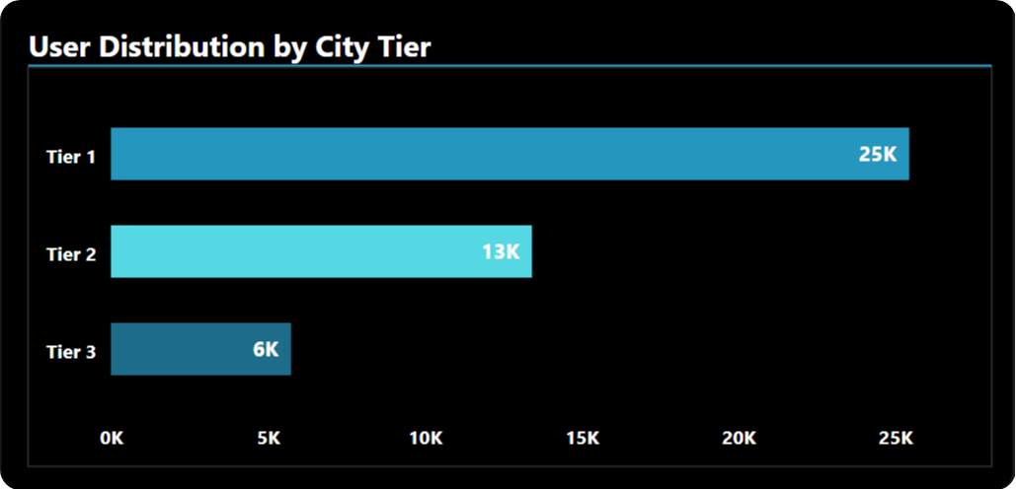
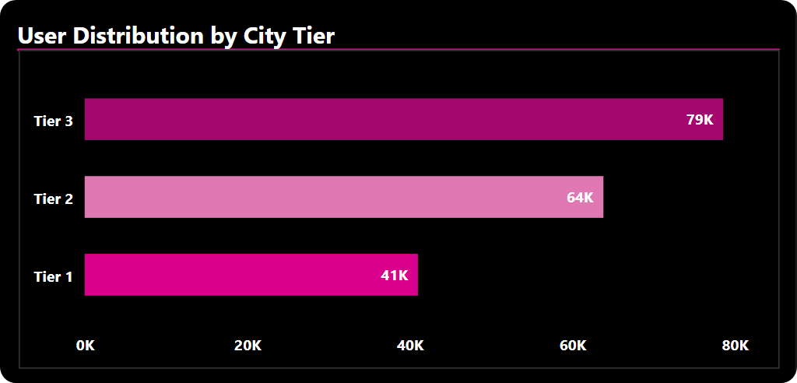
Jotstar
LioCinema
Key Insights By City Tier:
Jotstar’s Strength Lies in Tier 1 Cities – Most of its users come from metropolitan areas.
LioCinema Thrives in Tier 2 & Tier 3 Cities – It has a stronger presence in smaller cities, attracting a wider audience.
Jotstar Struggles in Tier 3 Markets – Its user base in these regions is significantly lower compared to LioCinema.
Notes:
In June, LioCinema experienced a sudden dip in user growth, dropping from 22.73% in May to 14.95%, before recovering in the following months. This decline could indicate factors such as reduced content releases, seasonal variations, or increased competition. Meanwhile, Jotstar maintained a consistently low growth rate, showing minimal impact during this period.

Slide 18
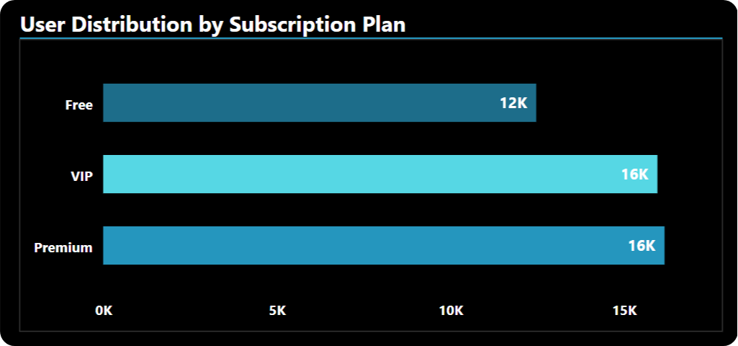
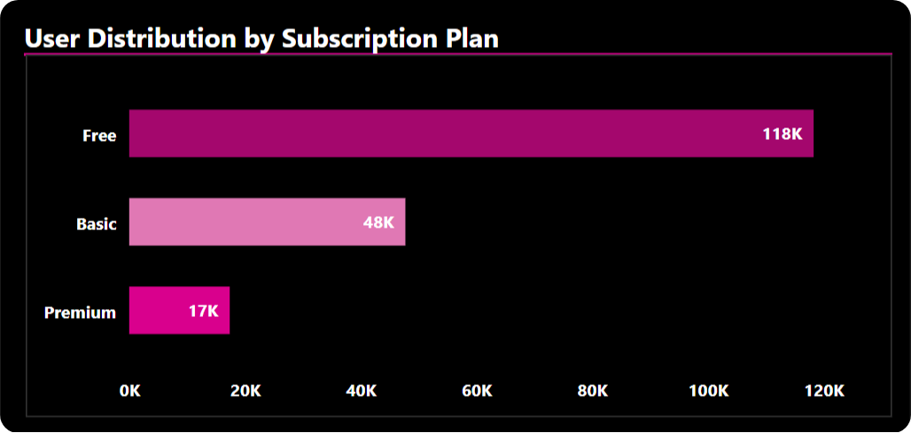
Jotstar
LioCinema
Key Insights By Subscription Plan:
Jotstar Leads the Premium Market – Despite having fewer total users than LioCinema, Jotstar boasts a higher number of premium subscribers.
LioCinema Relies on Free Users – The majority of its audience enjoys the platform without a paid subscription.
Paid Subscription Gap – A striking 72% of Jotstar’s users are paying subscribers(Premium OR VIP), while only 36% of LioCinema’s users(Premium or Basic) fall into the paid category.

Slide 19
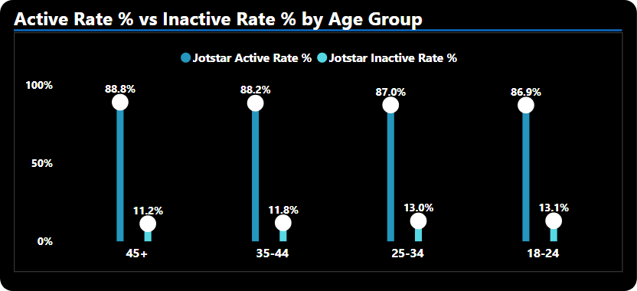
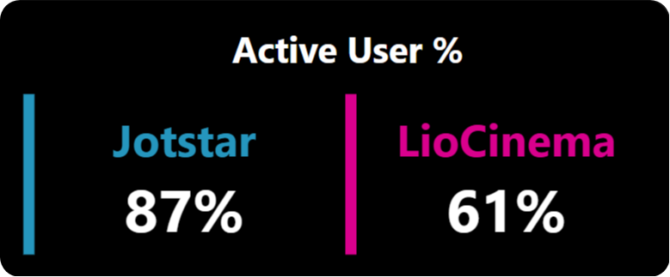
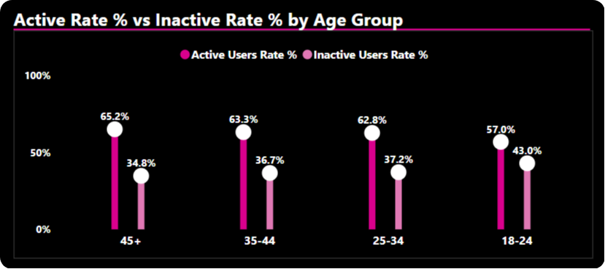
4. What percentage of LioCinema and Jotstar users are active vs. inactive? How do these rates vary by age group and subscription plan?
Jotstar
Key Insights by Age Group:
Jotstar Leads in Engagement Across All Ages – With an 80%+ active rate, Jotstar maintains strong user participation across every age group.
LioCinema Struggles with Young Viewers – A 43% inactivity rate among the 18-24 age group suggests challenges in retaining younger audiences.
Older Audiences Are More Engaged on LioCinema – The 45+ age group shows the highest activity (65%), but it's still lower than Jotstar’s engagement in 45+ Age group.
LioCinema

Slide 20
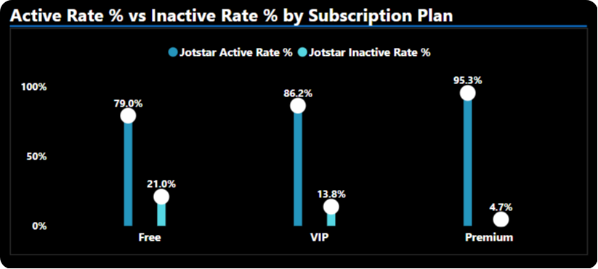
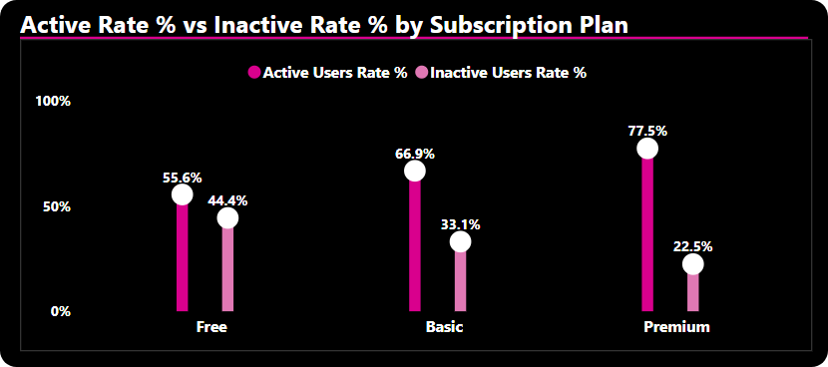
Jotstar
Key Insights by Subscription Plan :
Jotstar’s Premium Users Are Highly Engaged – With a 95% active rate, Jotstar’s premium subscribers show strong retention, followed by an 86.2% active rate in the VIP plan.
LioCinema’s Premium Engagement Lags Behind – Its 77% active rate in the premium plan is notably lower than Jotstar’s 95% active rate in Premium Plan
High Inactivity Among LioCinema’s Free Users – 44% of free users on LioCinema are inactive, whereas Jotstar maintains a much lower 21% inactivity rate in its free plan.
LioCinema

Slide 21
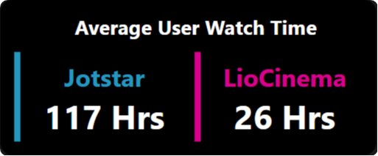
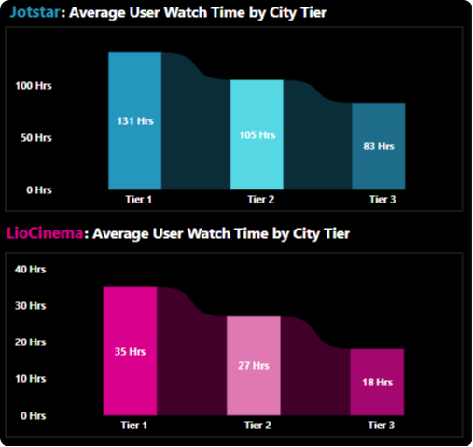
5. What is the average watch time for LioCinema vs. Jotstar during the analysis period? How do these compare by city tier and device type?
Key Insights by City Tier:
Jotstar Leads in Viewer Engagement – With an average watch time of 131 hours in Tier 1 cities and 105 hours in Tier 2, Jotstar maintains strong user engagement.
LioCinema Struggles Across All Tiers – Its average watch time is lower across all city tiers, with the weakest performance in Tier 3 cities.
Jotstar Outperforms in Tier 3 as Well – Although Jotstar's watch time in Tier 3 cities is lower than in other tiers, it still surpasses LioCinema's performance in the same segment.

Slide 22
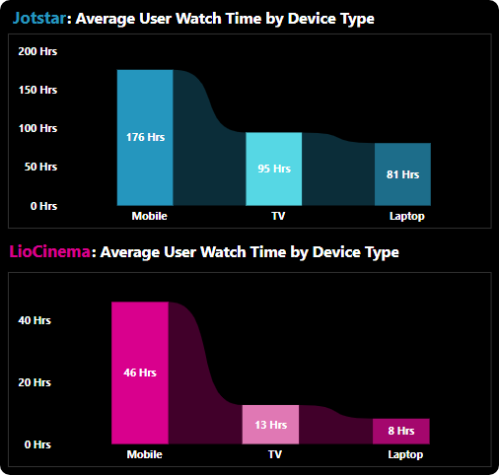
Key Insights by Device Type:
Mobile Dominates Watch Time on Both Platforms – Users on Jotstar and LioCinema spend the most hours watching content on mobile devices.
Jotstar Excels Across All Devices – It has higher average watch time on TV and laptops compared to LioCinema, indicating better engagement across multiple screens.
LioCinema Struggles on Larger Screens – Its average watch time on TV and laptops is significantly lower than mobile, suggesting a need for improved user experience on these devices.

Slide 23
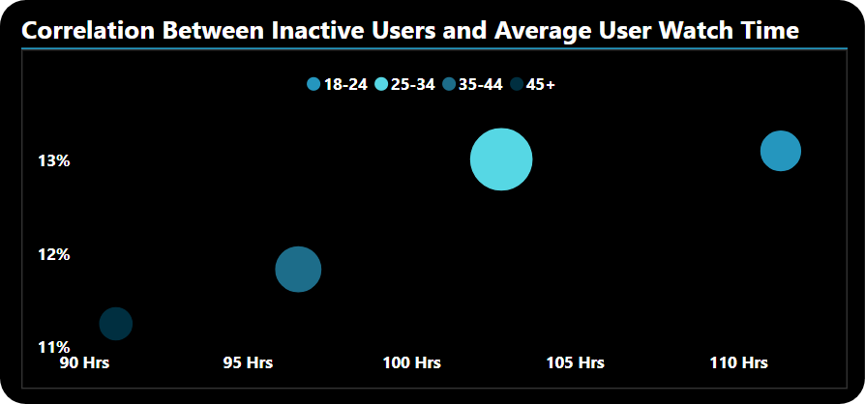
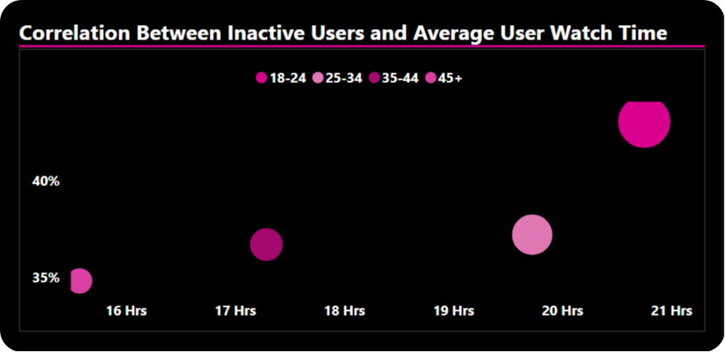
6.How do inactivity patterns correlate with total watch time or average watch time? Are less engaged users more likely to become inactive?
Jotstar
LioCinema
Key Insights By Age group:
For both Jotstar and LioCinema, there is no clear correlation between inactive users and average watch time across different age groups. Some age groups with higher watch time still show inactivity, while others with lower watch time remain engaged, suggesting that other factors beyond content consumption drive user inactivity.

Slide 24
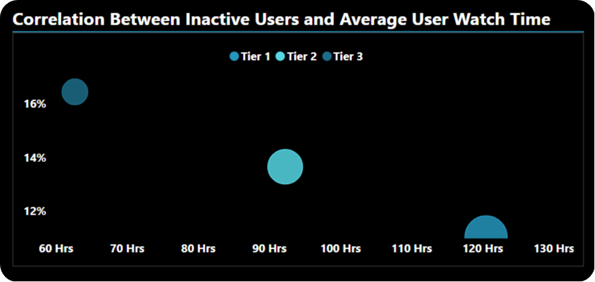
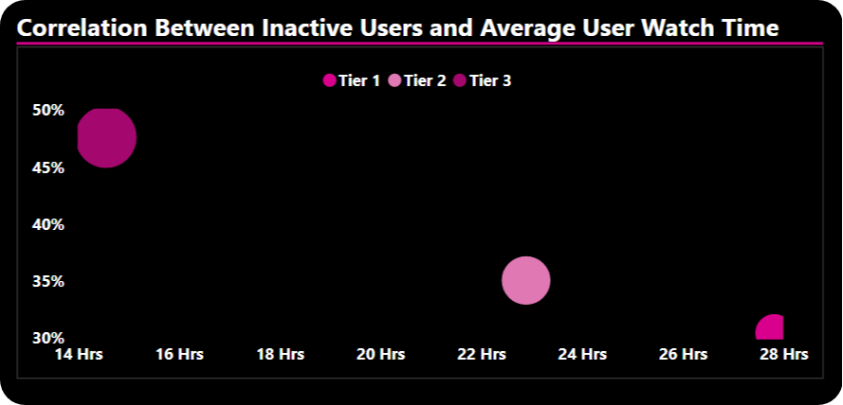
Jotstar
Key Insights by City Tier:
For both Jotstar and LioCinema, there is a strong correlation between the inactive user rate and their average watch time hours across different city tiers. Lower watch time tends to coincide with higher inactivity, emphasizing the role of engagement in user retention.
Tier 1 users on both Jotstar and LioCinema show high engagement, with a low inactivity rate and higher average watch time.
Tier 3 users, however, exhibit low engagement, with a higher inactivity rate and significantly lower watch time across both platforms.
LioCinema

Slide 25
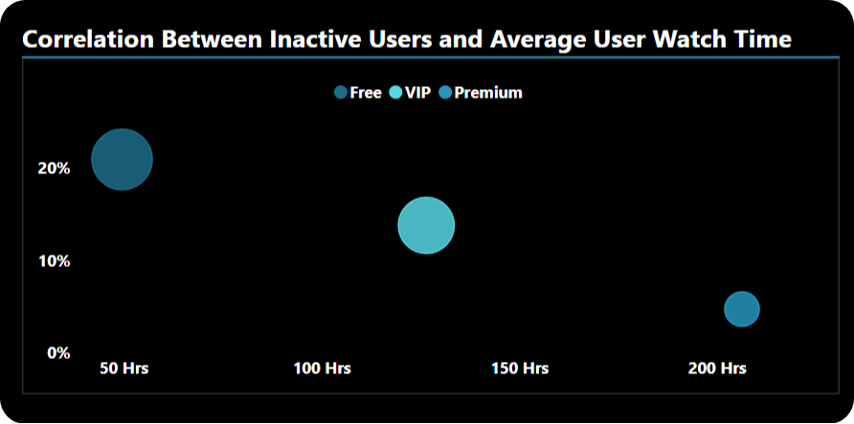
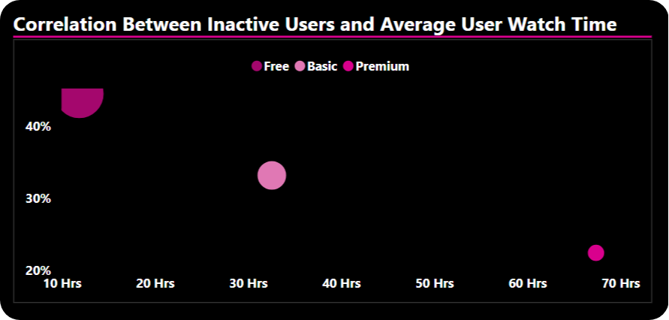
Jotstar
Key Insights By Subscription Plan:
There is a strong correlation between the inactive user rate and their average watch time across different subscription plans.
For both Jotstar and LioCinema, premium subscribers have a lower inactivity rate and higher average watch time, indicating strong engagement.
In contrast, free plan users exhibit a higher inactivity rate and lower average watch time, highlighting lower retention and engagement.
LioCinema

Slide 26
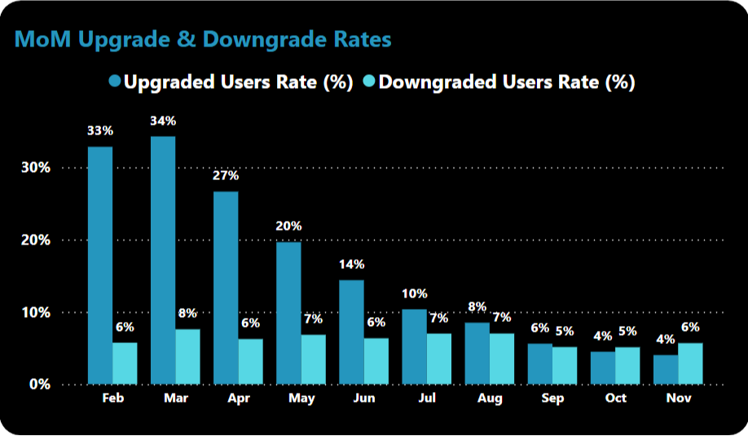
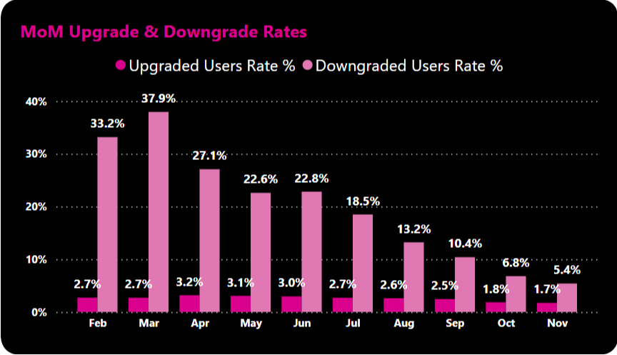
7. How do downgrade trends differ between LioCinema and Jotstar? Are downgrades more prevalent on one platform compared to the other?
Jotstar
Key Insights:
Jotstar has a higher upgrade rate, while LioCinema experiences a higher downgrade rate.
LioCinema's upgrade rate remains relatively stable from February to November, whereas Jotstar's upgrade rate shows a declining trend over the same period.
Jotstar’s downgrade rate remains steady, whereas LioCinema's downgrade rate shows a declining trend from February to November.
March marks the highest upgrade rate for Jotstar (34%) and the highest downgrade rate for LioCinema (38%).
LioCinema’s highest upgrade rate (3.2%) in April is significantly lower than Jotstar’s 27% in the same month.
Downgrades is more prevalent on one LioCinema compared to the Jotstar.
LioCinema

Slide 27
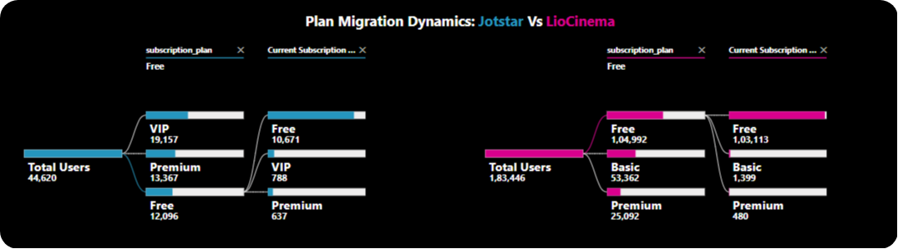
8. What are the most common upgrade transitions (e.g., Free to Basic, Free to VIP, Free to Premium) for LioCinema and Jotstar? How do these differ across platforms?
Key Insights:
Jotstar:
Free to VIP transition rate: 6.5%
Free to Premium transition rate: 5.2%
Overall Free to Paid transition rate: 11.75%
Jotstar outperforms LioCinema in converting free users to paid subscribers, with an overall transition rate nearly 7x higher!
LioCinema:
Free to Basic transition rate: 1.3%
Free to Premium transition rate: 0.4%
Overall Free to Paid transition rate: 1.7%

Slide 28
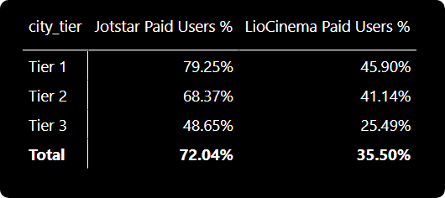
9. How does the paid user percentage (e.g., Basic, Premium for LioCinema; VIP, Premium for Jotstar) vary across different platforms? Analyze the proportion of premium users in Tier 1, Tier 2, and Tier 3 cities and identify any notable trends or differences.
Key Insights:
LioCinema’s paid user base is evenly distributed between Tier 1 and Tier 2 cities, reflecting a broader reach across different city tiers.
Meanwhile, Jotstar dominates Tier 1 cities, with a staggering 79.5% of its paid users coming from metro regions. Even in Tier 2 cities, Jotstar outperforms LioCinema (68.37% vs. 41.14%), reinforcing its strong presence in higher-tier markets.
However, when it comes to Tier 3 cities, LioCinema struggles the most, with only 25.49% of its paid users in these regions—lower than Jotstar, which has a comparatively better foothold.

Slide 29
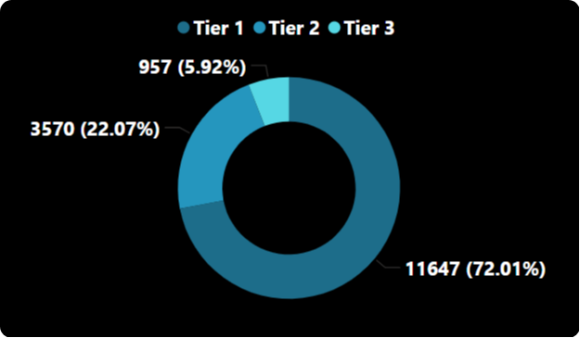
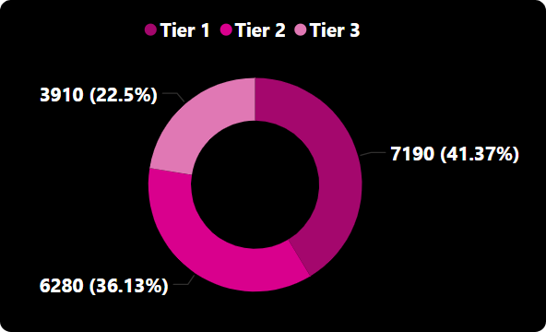
Jotstar
Key Insights of Premium Subscribers by City Tier:
When it comes to premium subscribers, Jotstar dominates in Tier 1 cities, with a massive 72% of its premium users concentrated in urban hubs.
In contrast, LioCinema has a more balanced distribution, with 41% in Tier 1 and a significant 36% in Tier 2.
The Tier 3 gap is notable—while only 6% of Jotstar's premium users come from smaller cities, LioCinema sees a much higher 23%.
This suggests that Jotstar’s premium base is heavily urban-centric, while LioCinema has broader penetration into smaller markets.
LioCinema

Slide 30
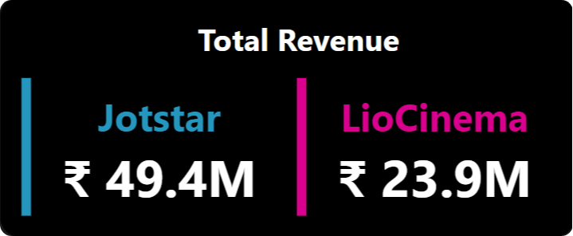
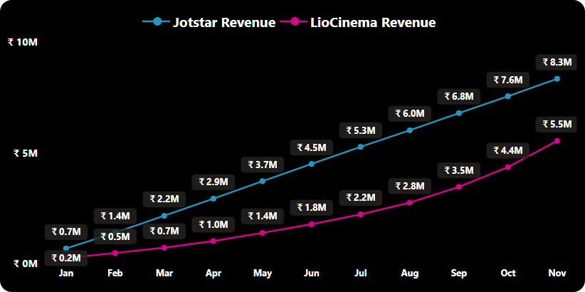
10. Calculate the total revenue generated by both platforms (LioCinema and Jotstar) for the analysis period (January to November 2024).
Key Insights:
Jotstar has generated 2X more revenue than LioCinema during the analysis period.
Jotstar has a much stronger revenue trajectory, consistently outperforming LioCinema.
Both platforms show steady revenue growth, with the highest revenue in November.
Jotstar’s revenue has grown by ~11.8x from Jan (0.7M) to Nov (8.3M).
LioCinema’s revenue has grown by ~27.5x from Jan (0.2M) to Nov (5.5M), showing a strong acceleration in later months.
LioCinema’s revenue growth is more rapid after June, likely due to an increase in paid users or marketing strategies.
Jotstar’s revenue growth is more stable and higher overall, indicating a well-established user base willing to pay.

Slide 31
Secondary Analysis
Notes:
Dataset was provided by codebasics team consists of two SQL databases: Jotstar.sql and LioCinema.sql. These databases contain detailed user and subscription data for both platforms

Slide 32
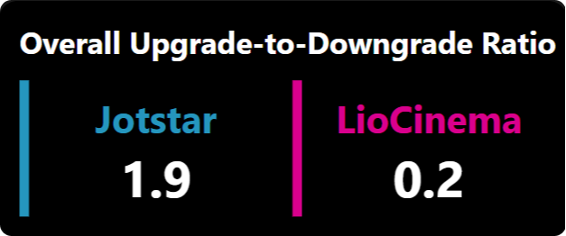
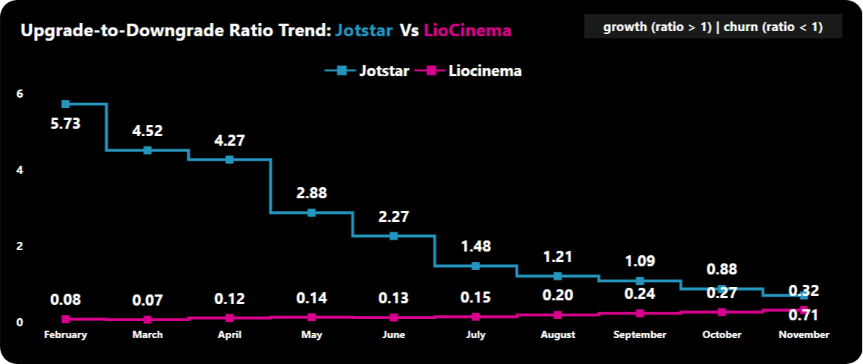
1. Calculate the Upgrade to Downgrade ratio of both platforms(Jotstar and LioCinema) for analysis period January to November 2024.
Key Insights:
Jotstar started strong, reaching its highest upgrade-to-downgrade ratio of 5.73 in February, meaning for every downgrade, 5.73 users upgraded.
However, over time, this ratio has seen a downward trend, suggesting a decline in upgrades relative to downgrades.
Despite the drop, Jotstar maintains an overall ratio of 1.9 (>1), indicating that for every downgrade, there are still 1.9 upgrades, keeping it in a healthy position.
LioCinema has consistently struggled, with an upgrade-to-downgrade ratio of less than 1 every month – meaning more users are downgrading than upgrading.
LioCinema’s overall ratio stands at 0.2 (<1), indicating that for every downgrade, only 0.2 users upgrade—a clear sign of retention challenges.
Even in its best months, LioCinema failed to break out of this pattern, highlighting the need for stronger incentives to push users toward higher-tier plans.

Slide 33
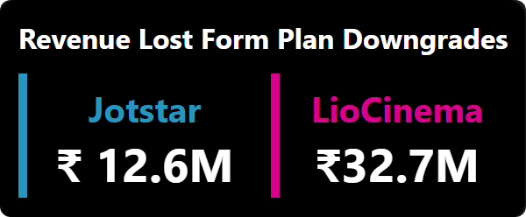
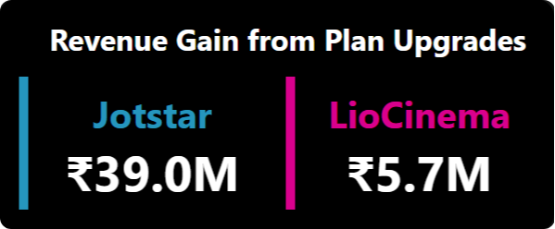
2.Calculate the Revenue Lost from plan downgrades and Revenue Gained from plan upgrades for both Jotstar and LioCinema.
Key Insights:
Jotstar is in a strong position—for every ₹1 lost in downgrades, it gains ₹3 from upgrades, keeping its revenue flow positive.
LioCinema, however, is losing more than it gains—downgrade losses (₹32.7M) far exceed upgrade gains (₹5.7M), highlighting a major retention challenge.
LioCinema faces a much higher revenue loss from downgrades (₹32.7M) compared to Jotstar (₹12.6M), indicating a weaker retention of premium users. Jotstar’s losses are significantly lower, suggesting better user engagement and plan sustainability.

Slide 34
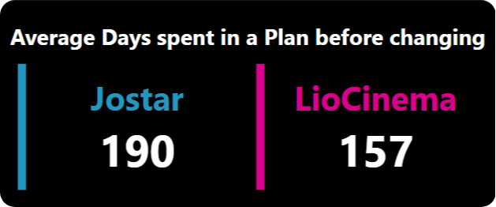
3.What is the average number of days a customer stays on a plan before switching to another during the analysis period (January to November 2024)?
Key Insights:
When it comes to plan stability, Jotstar users stay longer before making a switch.
On average, a Jotstar subscriber spends 190 days on a plan before upgrading or downgrading, while LioCinema users switch earlier, averaging just 157 days.
This suggests that Jotstar’s plans offer better long-term value or content satisfaction, whereas LioCinema users may be more price-sensitive or seeking better alternatives.

Slide 35
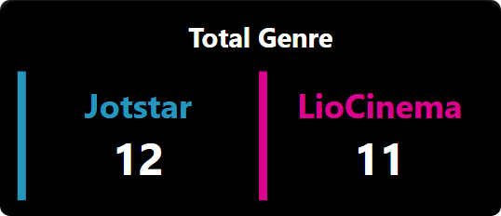
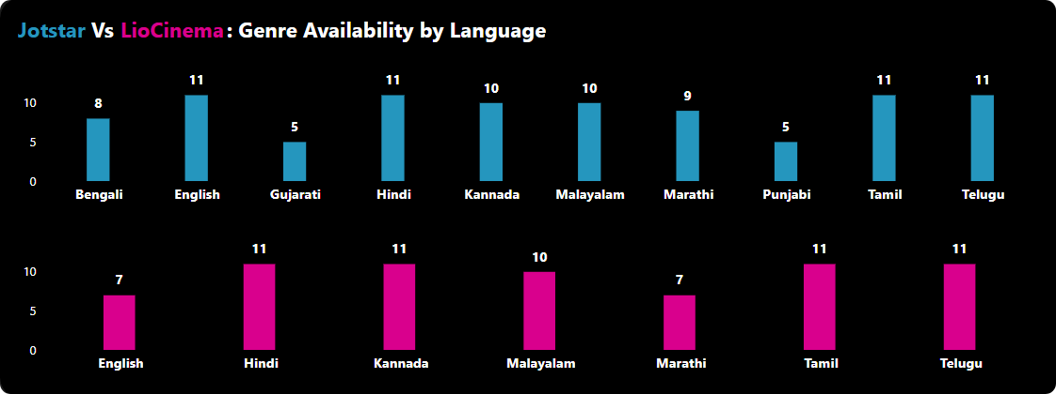
4.How many genres are available across different languages in Jotstar and LioCinema?
Key Insights:
Jotstar leads in English content, offering 11 genres, while LioCinema provides only 7 genres in English.
Jotstar maintains a consistent genre count (11) across major languages—English, Tamil, Telugu, and Hindi.
LioCinema excels in regional content, with Kannada, Tamil, Telugu, and Hindi featuring the highest genre variety (11 genres each).
Jotstar's weakest genre presence is in Gujarati and Punjabi (only 5 genres), while LioCinema has the lowest variety in English and Marathi (7 genres each).

Slide 36
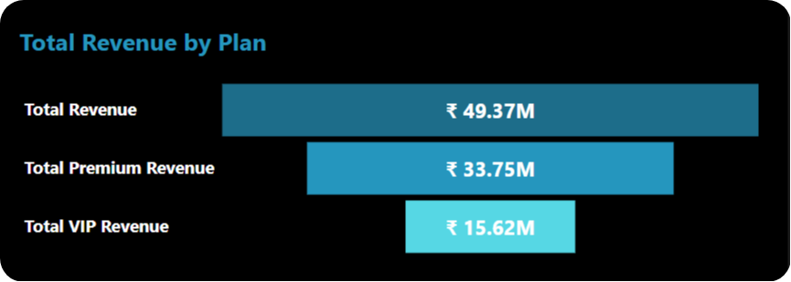
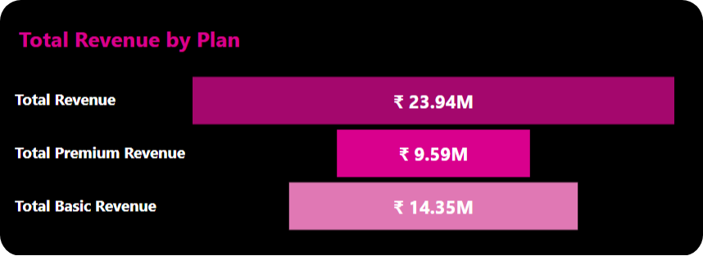
5.Calculate the revenue gained from each subscription plan for both Jotstar and LioCinema during the analysis period (January to November 2024).
Jotstar
Key Insights:
Jotstar’s revenue is heavily skewed toward its Premium plan, which contributes ₹33.75M (68.4%), whereas the VIP plan generates only ₹15.62M (31.6%) from a total revenue of ₹49.37M.
LioCinema’s revenue is heavily skewed toward its Basic plan, which contributes ₹14.35M (59.9%), whereas the Premium plan generates only ₹9.59M (40.1%) from a total revenue of ₹23.94M.
Jotstar’s Premium plan significantly outperforms LioCinema’s Premium plan (₹33.75M vs. ₹9.59M), highlighting its strong appeal among high-paying users.
LioCinema’s Basic plan revenue (₹14.35M) surpasses its Premium revenue yet still falls short of Jotstar’s VIP plan revenue (₹15.62M).
LioCinema

Slide 37
Further Analysis & Recommendations
Notes:
Dataset was provided by codebasics team consists of two SQL databases: Jotstar.sql and LioCinema.sql. These databases contain detailed user and subscription data for both platforms

Slide 38
1. What strategies can the merged platform implement to increase engagement among inactive users and convert them into active users?
Personalized Recommendations – AI-driven content suggestions & notifications.
Revamped Free & Trial Plans – Limited-time premium access & affordable short-term plans.
Gamification & Rewards – Loyalty points, badges, and binge-watching milestones.
Optimized UX – Seamless navigation, data-saving streaming options.
Targeted Marketing – Win-back emails, social media retargeting.
Exclusive & Regional Content – More regional language content & exclusive releases.
Interactive Features – Watch parties, user reviews, and polls.
These strategies can drive user re-engagement and increase active subscriptions.
Personalized Re-Engagement Campaigns (Emails, Push Notifications, SMS)

Slide 39
2. What type of brand campaigns should the merged platform launch to establish itself as the go-to OTT platform in India?
Star-Driven Campaigns – Collaborate with top Bollywood & regional celebrities.
Regional Connect – Hyper-local ads highlighting diverse language content.
Big-Ticket Sports Partnerships – Exclusive cricket & football sponsorships.
Social Media Buzz – Hashtag challenges, influencer collaborations & viral trends.
Nostalgia Marketing – Reviving classic shows & movies to attract all age groups.
Festival-Themed Promotions – Special discounts & exclusive releases during major festivals.
User-Generated Content – Engage audiences with fan reviews & contests.
Cross-Brand Collaborations – Bundle offers with telecom, food delivery & e-commerce apps.

Slide 40
3. How should the merged platform price its subscription plans to compete effectively while maintaining profitability?
Freemium Model – Ad-supported free tier with limited access to attract a larger audience.
Affordable Entry Plan – A low-cost basic plan targeting price-sensitive users.
Value-Packed Mid-Tier – Competitive pricing for HD access & multi-device streaming, ensuring strong user retention.
Premium Plan for High-ARPU Users – Offer exclusive content, early access, and enhanced features like 4K & Dolby Atmos.
Regional & Mobile-Only Plans – Lower-priced subscriptions for mobile users and regional content lovers.
Bundled Partnerships – Collaborate with telecom providers, ISPs, and DTH services for discounted subscriptions.
Annual Discounts & Family Plans – Encourage long-term commitments with cost-effective family & yearly plans.

Slide 41
4. How can the platform leverage partnerships with telecom companies to expand its subscriber base?
Bundled Subscription Plans – Offer free or discounted OTT access with mobile and broadband plans to drive adoption.
Data + Streaming Packs – Introduce exclusive data plans with unlimited streaming benefits, attracting heavy mobile users.
Preloaded App & One-Click Access – Ensure the OTT app comes pre-installed on telecom devices with seamless login via mobile numbers.
5G & High-Speed Internet Tie-Ups – Leverage 5G rollouts to promote high-quality streaming and immersive viewing experiences.
Loyalty Rewards & Cashbacks – Provide telecom users with subscription discounts, redeemable points, or cashback on renewals.
Exclusive Content & Early Access – Offer special content premieres and live events for users subscribed via telecom partners.
Joint Marketing Campaigns – Run co-branded promotions, leveraging telecom companies' vast reach to increase visibility.

Slide 42
5. What role can AI and machine learning play in personalizing the user experience and improving content discovery?
Personalized Recommendations – AI-driven algorithms analyze user behavior, watch history, and preferences to suggest tailored content, increasing engagement.
Smart Search & Voice Assistants – AI-powered search understands intent, enabling faster, more accurate content discovery via text or voice.
Dynamic UI Customization – ML adapts the homepage layout, banners, and featured content based on individual viewing patterns.
Predictive Content Curation – AI identifies trending genres and recommends shows before users even search for them.
Automated Content Tagging – AI classifies movies and series by mood, theme, and sentiment, enhancing discoverability.
Churn Prediction & Retention Strategies – ML detects inactivity patterns and triggers personalized re-engagement offers or reminders.
Ad & Monetization Optimization – AI serves targeted, non-intrusive ads based on user interests, maximizing revenue without disrupting the experience.

Slide 43

6. Who should be the brand ambassador for the newly merged OTT platform ?
1. Strong Pan-India Appeal
Dulquer has a massive fanbase across multiple regions—Malayalam, Tamil, Telugu, and Hindi industries.
His multi-language reach aligns perfectly with an OTT platform catering to diverse audiences.
Notably, his Bollywood films like Karwaan and Chup have further expanded his reach beyond the South.
2. OTT Success & Digital Footprint
His OTT debut Salute (2022) on SonyLIV was one of the most-watched Malayalam films on the platform.
Guns & Gulaabs (Netflix, 2023) was a hit in the Hindi market, showcasing his appeal beyond South India.
He has over 13 million Instagram followers, ensuring high digital engagement—key for promoting an OTT brand.
3. Youth Icon & Relatable Persona
Dulquer is hugely popular among Gen Z & Millennials, OTT's primary audience.
His charming, down-to-earth personality makes him a relatable and aspirational brand ambassador.
His association with brands like Zomato, Myntra, and AM/PM Watches has shown his effectiveness in digital promotions.
4. Successful Brand Endorsements & Marketability
Dulquer has been a brand ambassador for multiple national & regional brands, proving his commercial impact.
His bilingual skills (Malayalam, Tamil, Hindi, Telugu) allow him to seamlessly promote content across India.
Movies & Series

Slide 44

1. Unmatched Popularity & Fanbase
2. Strong Connection with Sports Streaming Viewers
With the rise of digital sports consumption (IPL, World Cup streaming), Kohli’s association would directly resonate with sports fans on the platform.
3. Proven Success in Brand Endorsements
Kohli has endorsed top brands like Puma, MRF, Audi, and MPL, proving his marketing power.
4. Youth Icon & Fitness Inspiration
Kohli is not just a cricketer; he’s a fitness icon and trendsetter for young Indians, aligning well with the active OTT audience.
He is a household name across all demographics, making him the perfect face for an OTT platform looking to expand its user base.
His presence could boost live sports streaming engagement, attracting cricket fans who are a major audience for OTT services.
His ability to drive engagement and influence purchase decisions makes him a high-impact ambassador.
His persona adds credibility and aspirational value to the platform.
Virat Kohli is India's most followed athlete with 270M+ Instagram followers, ensuring massive digital reach.
Sports

Slide 45
"With the right strategies, Lio-Jotstar has the potential to become India’s leading OTT platform. This analysis provides a data-driven roadmap to make this merger a success!”
Conclusion

Slide 46




Thank You !
Live Dashboard
My Portfolio
GitHub
s.dinesh.works@gmail.com

